Slide 1

Basic Details of the Team and Problem Statement
Organization Name : Government Of Gujarat
PS Code: SIH1362
Problem Statement Title: Student Dropout Analysis for School Education
Team Name: Lunar-Light Code
Team Leader Name: RAKSHITH KUMAR B
Institute Name: Presidency University
Theme Name: Smart Education

Slide 2
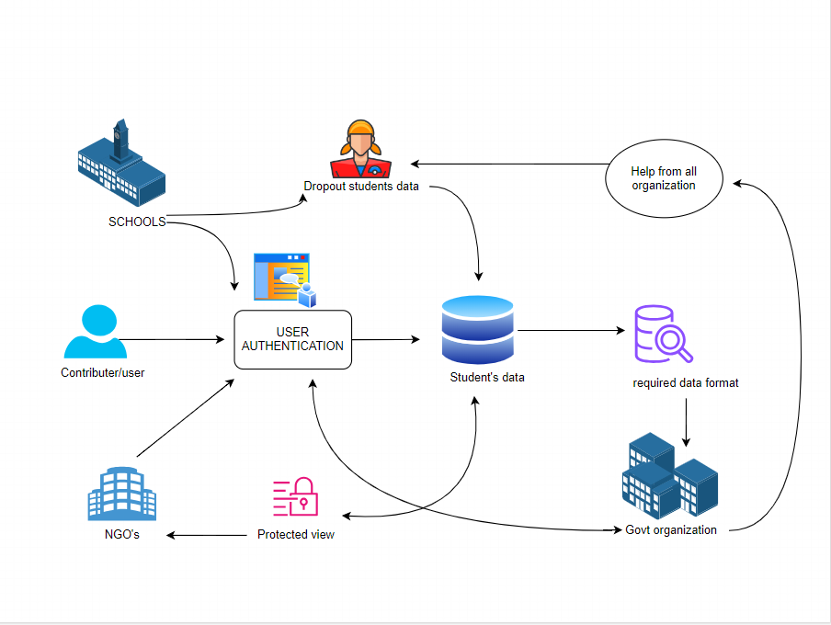
Idea/Approach Details
Describe your idea/Solution/Prototype here:
School-Wise Analysis:
We need reliable and accurate data about why students drop out of school at the school level.
We also need money to help those schools where many students are leaving.
Area-Wise Analysis:
We need good systems to collect data in different areas, like cities, villages, and remote places.
We should have a budget (money) to solve problems specific to each area.
Gender-Wise Analysis:
We want to know if boys and girls are dropping out of school for different reasons.
We should make rules and programs that consider the culture and society when boys or girls leave school.
Caste-Wise Analysis:
We need to understand if students from different social backgrounds are leaving school more.
We should make sure that our rules and programs are against any unfair treatment.
Age/Grade-Wise Analysis:
We want to find out at which age or grade students are leaving school more often.
We should make sure that what we teach matches the age and grade of the students.
Technology stacks :
HTML5 , TAILWIND CSS.
CASCADING STYLE SHEETS , BOOTSTRAP.
JAVASCRIPT, TYPESCRIPT.
REACT.JS , MYSQL.
NODE.JS , MONGODB.
EXPRESS.JS , REDUX.
GIT VERSION CONTROL

Slide 3
Idea/Approach Details
Describe your Use Cases here
1. Early Warning: Find students at risk and help them with things like counseling or tutoring.
2. Trends: See if dropout rates are changing over time, especially in certain groups or grades.
3. Demographics: Check if different groups of students are more likely to drop out, like boys or girls, rich or poor students, or those who speak different languages.
4. Root Causes: Talk to students, parents, and teachers to figure out why some students leave, like bullying or family problems.
5. Courses and Programs: Check if certain classes or programs make students more likely to drop out and change them if needed.
6. Family and Community: Work with families and the community to make sure students have good support at home.
7. Mentoring and Counseling: Provide help for students with emotional or academic issues and see if it helps them stay in school.
8. Tracking: Keep an eye on students who left school early and try to get them back on track.
9. Data-Driven Decisions: Use data tools to keep an eye on dropout rates and see if the things you're doing to help are working.
10. Policy: Use what you find to make new rules or ideas to stop students from dropping out.
Describe your Dependencies / Showstopper here
Data Quality:
Good data is vital. If we don't collect accurate and complete information, our plans and ideas might not work well.
Resource Allocation:
To make our plans work, we need enough money and people to help. Sometimes, our plans might not work if we don't have the right resources.
Policy and Rules:
We need fair and inclusive rules and laws to make sure everyone has an equal chance to learn. These rules help us treat everyone the same way.
Community Involvement:
We need to work together with families and local groups to make our plans succeed. Teamwork is important!
Training and Skills:
Teachers and school leaders should have the knowledge and skills to help students. If they don't, our plans may not be effective.
Monitoring and Checking:
We should keep an eye on how well our plans are working. If they're not working as expected, we can change them to make them better.

Slide 4
Team Member Details
Team Leader Name: RAKSH IT H KUMAR B
Branch : B Tech Stream : CSE Year : ||
Team Member 1 Name: P DEEPT H I MOTAIAH
Branch : B Tech Stream : CSE Year : ||
Team Member 2 Name: N IT H IN G RAO
Branch : B Tech Stream : CSE Year : ||
Team Member 3 Name: RAKSH IT HA D S
Branch : B Tech Stream : CSE Year : ||
Team Member 4 Name: AN UJA SAL IL WAIKUL
Branch : B Tech Stream : CSE Year : ||
Team Member 5 Name: KIRAN KUMAR B L
Branch : B Tech Stream : CSE Year : ||
Team Mentor 1 Name: Type Your Name Here
Category (Academic/Industry): Expertise (AI/ML/Blockchain): Domain Experience (in years):
Team Mentor 2 Name: Type Your Name Here
Category (Academic/Industry): Expertise (AI/ML/Blockchain): Domain Experience (in years):

